Slide 1

KURSUKAL ALGORITHM
PRESENTATION

Slide 2
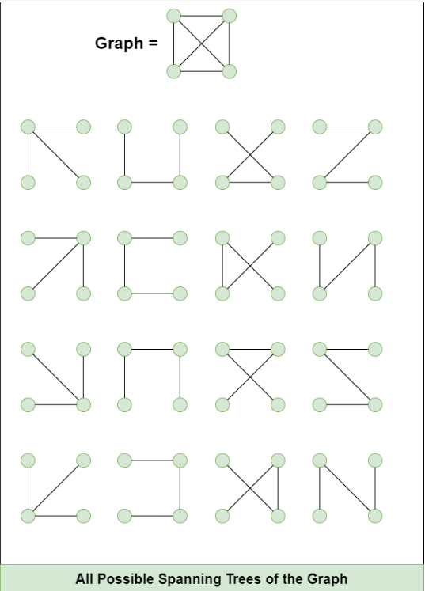
WHAT IS
SPANNING TREE ?
A spanning tree is a subset of Graph G, such that all the vertices are connected using minimum possible number of edges. Hence, a spanning tree does not have cycles and a graph may have more than one spanning tree.

Slide 3
PROPERTIES OF A SPANNING TREE:
A Spanning tree does not exist for a disconnected graph.
For a connected graph having N vertices then the number of edges in the spanning tree for that graph will be N-1.
A Spanning tree does not have any cycle.
We can construct a spanning tree for a complete graph by removing E-N+1 edges, where E is the number of Edges and N is the number of vertices.
Cayley's Formula: It states that the number of spanning trees in a complete graph with N vertices is N^(N−2).
For example: N=4, then maximum number of spanning tree possible =4^(4−2)= 16 (shown in the above image).

Slide 4
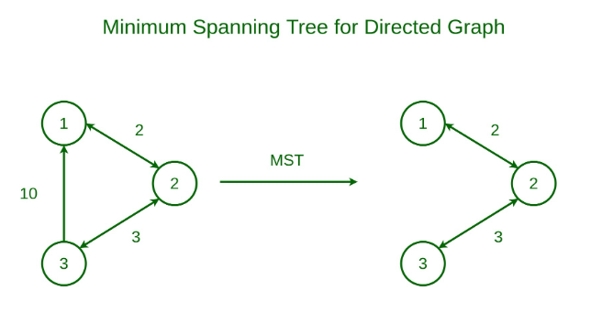
MST ?
WHAT IS
Minimum Spanning Tree
A minimum spanning tree (MST) is defined as a spanning tree that has the minimum weight among all the possible spanning trees.

Slide 5
WHAT IS
KURUSKAL ALGORITHM ?
Kruskal's algorithm is based on a greedy approach, whose goal is to find the shortest path in a graph with a minimum cost. Kruskal's algorithm is used to find the shortest way between two connected weighted nodes, it divides a graph into a forest and considers each node as an individual tree. These trees can only link to each other if the edge connecting them has a low value and doesn’t generate a cycle in the MST structure.

Slide 6
USE CASES OF KURUSKAL ALGORITHM ?
🛰️ 1. Computer Network Design (LAN/MAN)
Goal: Connect multiple computers/servers with minimal cabling or latency.
Use case: Corporate offices or data centers often apply MST to optimize internal wiring.
🛣️ 2. Road/Highway Construction
Goal: Connect cities with roads so every city is reachable, with the least total road length or cost.
How Kruskal helps: It avoids building unnecessary roads and ensures all cities are connected.
Example: Planning road networks between villages or districts using cost-effective paths.

Slide 7
STEP BY STEP WORKING OF KURSKAL’S ALGORITHM
Rules or Characteristics of Kurskal’s Algorithm
No Loop or Cycle
Cost must be minimum
Graph must be connected
Edges always (n-1)

Slide 8
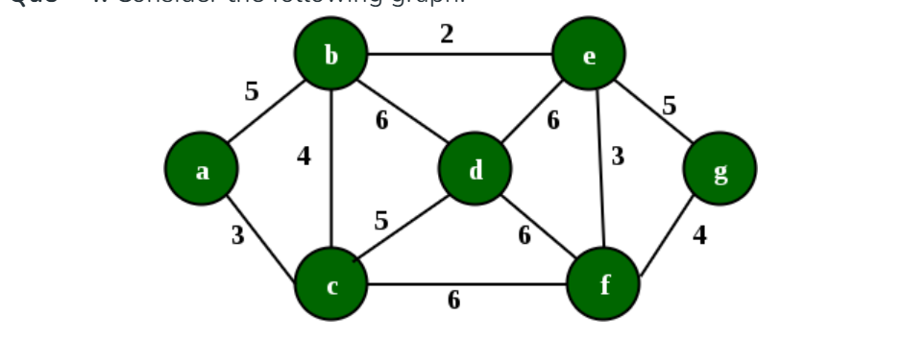
KURSUKAL ALGORITHM DIAGRAM

Slide 9
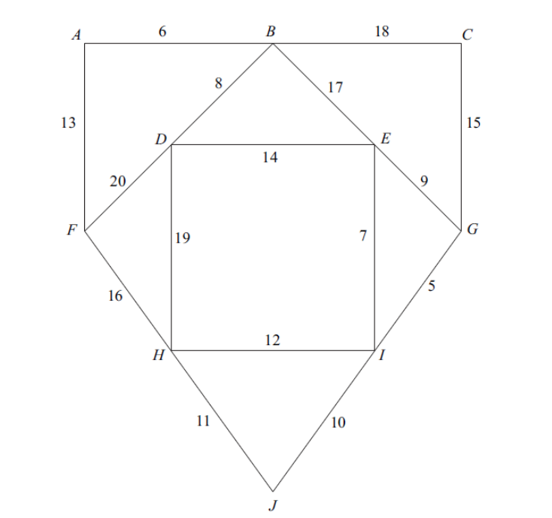
CLASS ACTIVITY

Slide 10
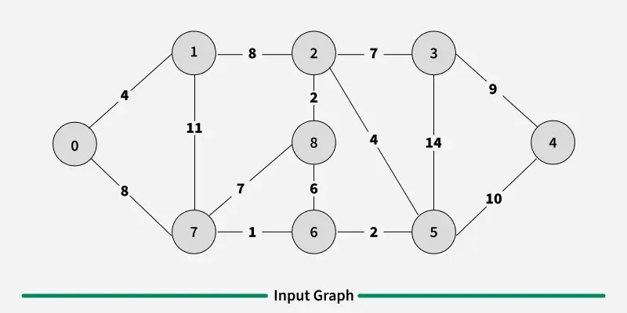
STEPS FOR KURUSKAL

Slide 11
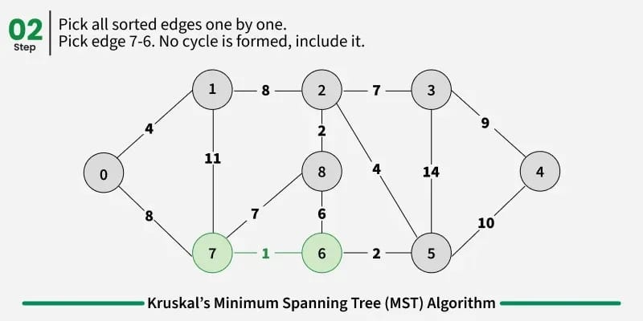
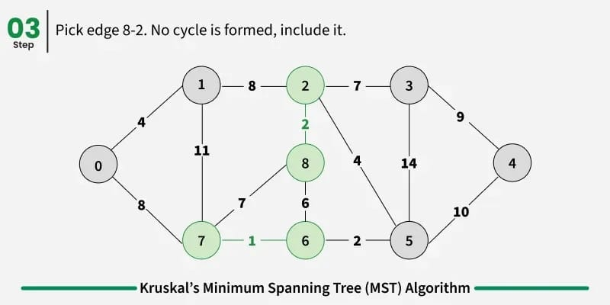
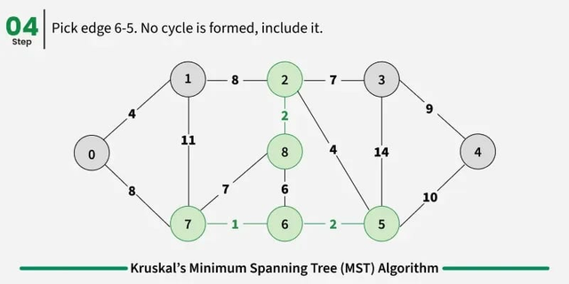
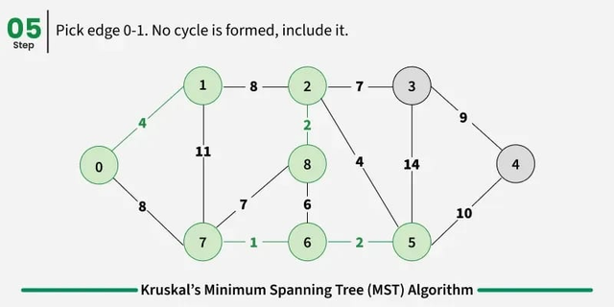
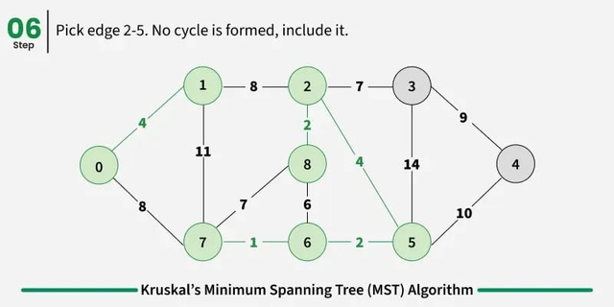
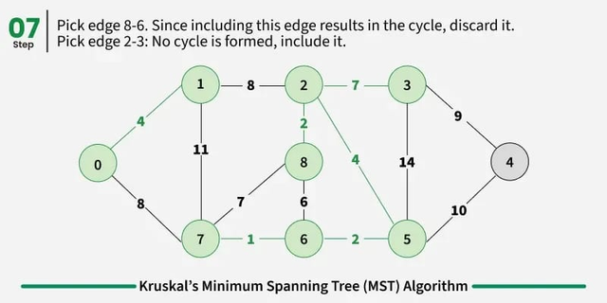
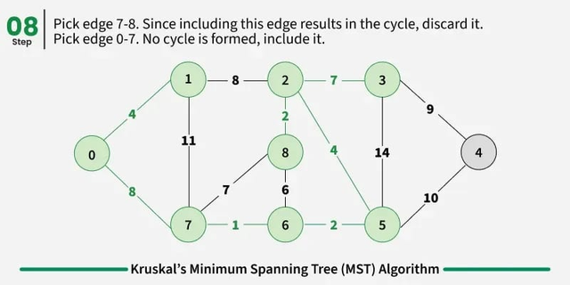
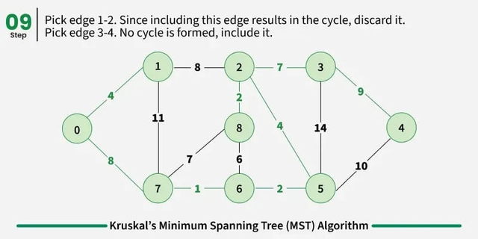

Slide 12
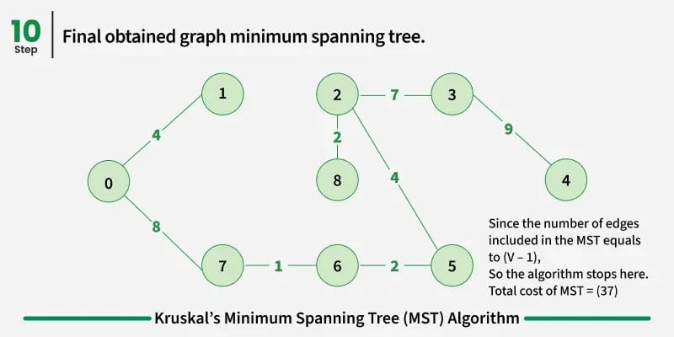

Slide 13
TIME AND SPACE COMPLEXITY IN KRUSKAL’S ALGORITHM
What is Time and Space Complexity?
Time Complexity: Measures how much time an algorithm takes to run, depending on the size of the input.
Space Complexity: Measures how much memory an algorithm uses during execution.

Slide 14
TIME COMPLEXITY
Time Complexity = O(E log E)
Where:
E = number of edges
V = number of vertices

Slide 15
TIME AND SPACE COMPLEXITY IN KRUSKAL’S ALGORITHM
⚙️ Why?
Sorting Edges → O(E log E)
Kruskal starts by sorting all the edges based on weight.
Sorting E items takes O(E log E) time using Merge Sort, Heap Sort, or any efficient algorithm.
This is the most expensive step and dominates the total time.

Slide 16
TIME AND SPACE COMPLEXITY IN KRUSKAL’S ALGORITHM
Union-Find Operations → O(E × α(V))
For each edge, we use Find and Union to check for cycles and merge sets.
These operations are almost constant time (α(V) is inverse Ackermann, nearly constant for all practical inputs).
Final Time = O(E log E)
Because O(E log E) > O(E × α(V)) for large inputs

Slide 17
🔶 SPACE COMPLEXITY
Space Complexity = O(V + E)
📦 Why?
Edge Storage → O(E)
We need to store all edges to sort and process them.
Union-Find Arrays → O(V)
We use two arrays:
parent[] to track the representative of each set
rank[] (or size[]) to keep trees balanced
✅ Final Space = O(V + E)
Because we store all edges and maintain sets for all vertices.

Slide 18
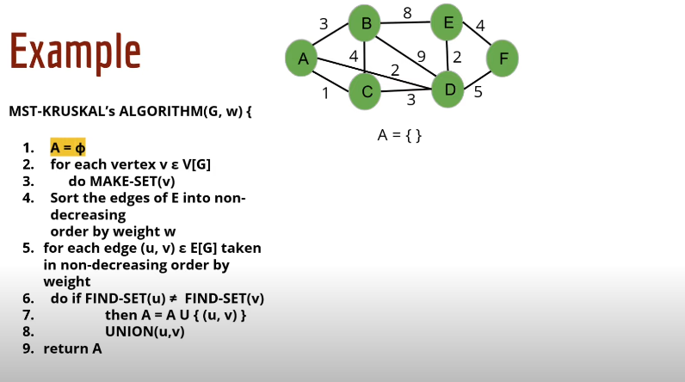
🔶 TIME COMPLEXITY

Slide 19
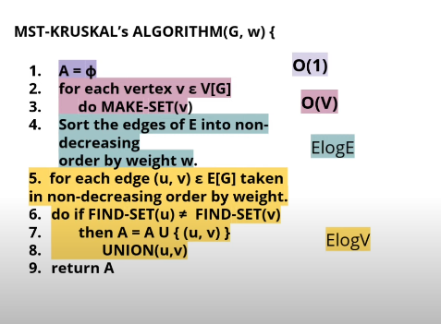
🔶 TIME COMPLEXITY

Slide 20
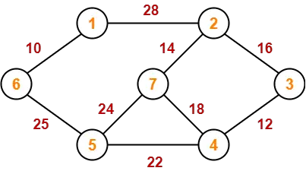
PRACTICE PROBLEMS
Problem-01:

Slide 21
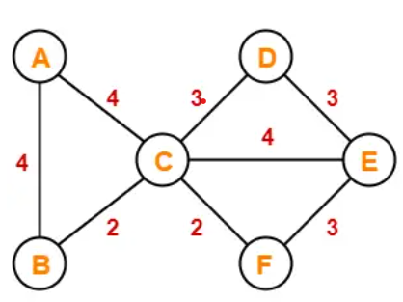
Problem-02:

Slide 22
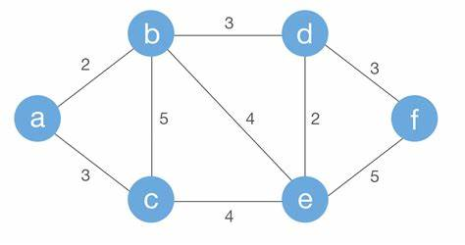
PROBLEM:03

Slide 23

THANK
YOU

